Slide 1
Week 9 – binary Search trees
Team “Encoder”
Oleksandr Kuprii
Illia Kara

Slide 2
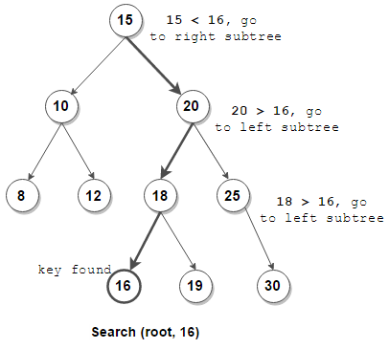
What we have learnt
We have learnt how to implement binary search trees. We have compared the time complexity of the operations on a balanced tree and on an unbalanced tree.

Slide 3
SURprises
Usage of a replace_child function to remove a node.

Slide 4
Problems
Activity #8,9,11. Understanding why do we need to remove with a replace_child.

Slide 5
Still unclear
Importance of using replace_child while deleting

Slide 6
Suffix trees

Slide 7
Suffix tree (pat tree)
A suffix is a compressed tree containing all the suffixes of the given text as their keys and positions in the text as their values.

Slide 8
Why using them
Once constructed, several operations can be performed quickly
Locating substring in S
Locating a substring if a certain number of mistakes are allowed
Locating matches for a regular expression pattern

Slide 9
🍌🍌🍌
banana\0
anana\0
nana\0
ana\0
na\0
a\0
\0
=>

Slide 10
No title
{bear, bell, bid, bull, buy, sell, stock, stop}

Slide 11


